Slide 1

Topic models
LEcTURE #4 Text analysis in R
Laura Wolton

Slide 2
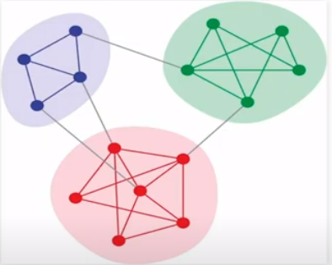
What are differences between topic models and Text Networks?
Topic models and Text Networks have a lot of similarities
Unsupervised
Goal to pull out meanings in text
but they are based on different modelling approaches
Topic models – Bayesian inference model
Text Networks – community detection models
Networks have a language associated with them
Network-A set of nodes and connections (edges) to each other
Ties, nodes, vertices edges
Can show a relationship between units
Looking for similarities across documents in the way they speak

Slide 3
What are Topic models?
Topic models
efficient way to analyze large volumes of text
Most common is Latent Dirichlet Allocation, or LDA
LDA is considered a form of statistical machine learning
LDA is a form of text data mining
Clustering words into “topics”.
Clustering documents into “mixtures of topics”.
associates each document with a probability distribution over topics
topics are probability distributions over words

Slide 4
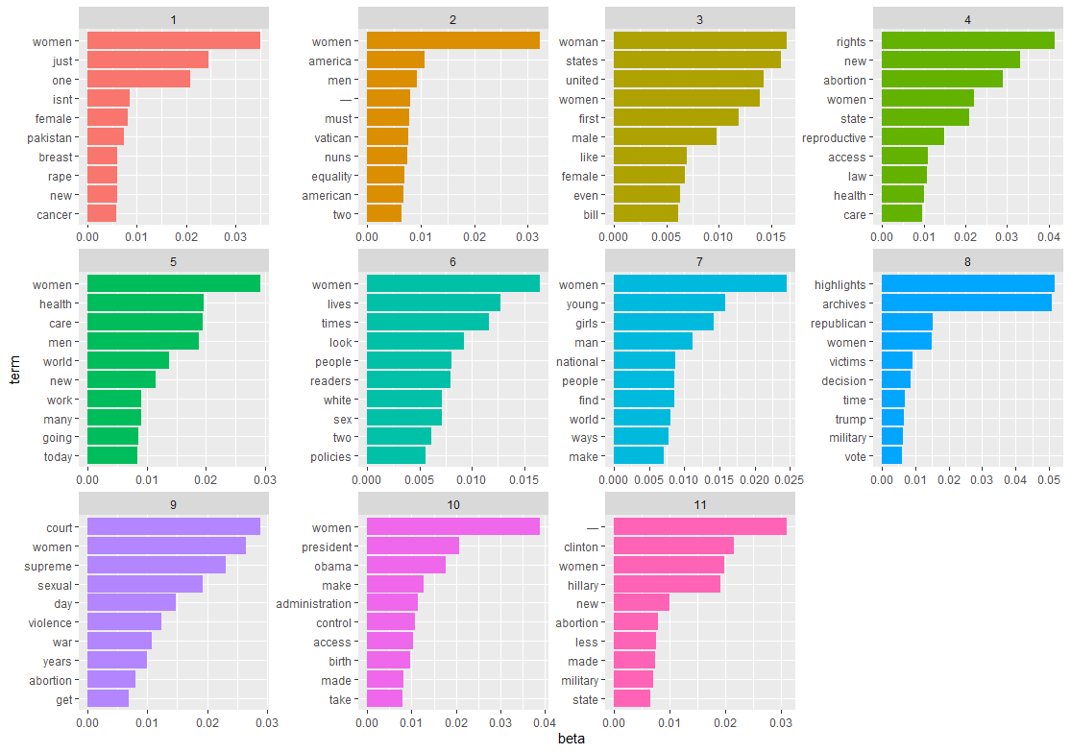

Slide 5
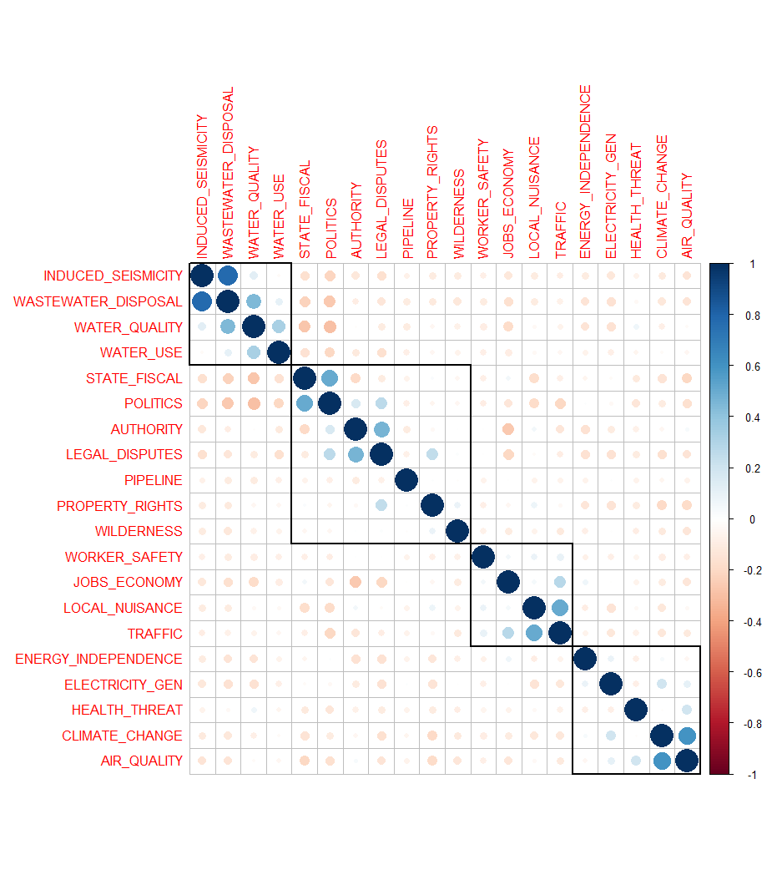
What do they mean?
Some literature suggests they are related to issue frames or subtopics
verification of issue frames
Groupings you may not have considered
My general sense is to start with theoretical idea of what frames might be so that you can know how narrow or wide

Slide 6
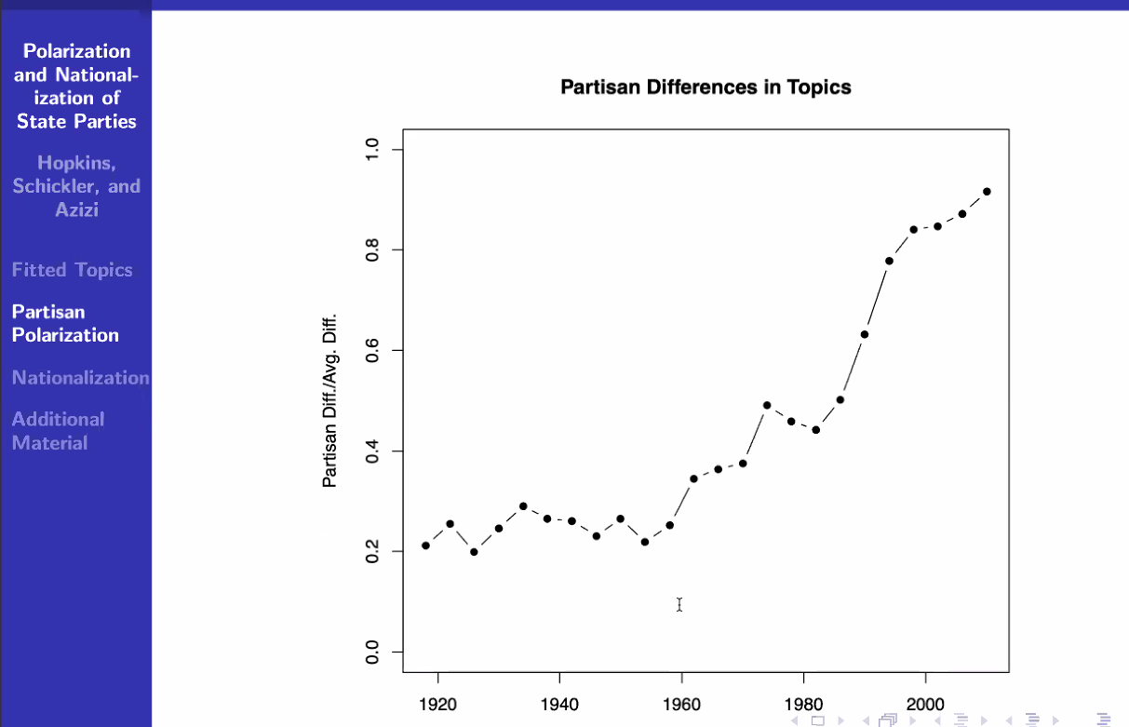
What do they mean?
Hopkins, Schickler, and Azizi
Daniel Hopkins - some in book - The Increasingly United States – Political parties

Slide 7
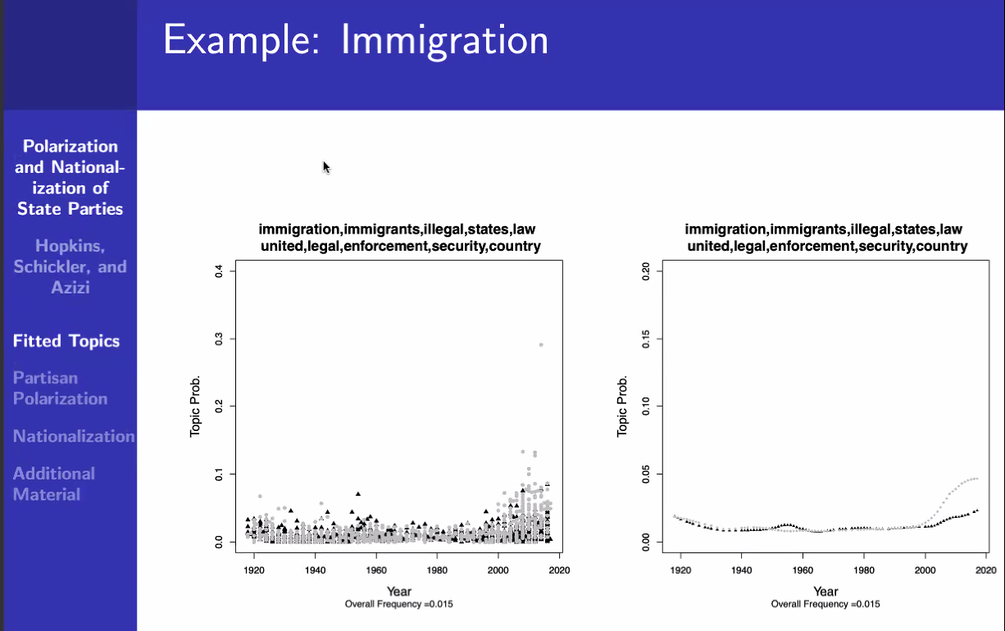

Slide 8
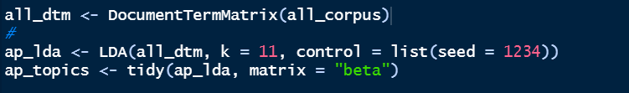
Let’s look at a call
For the package topicmodels
Documents need to be in document term matrix
What the?
A document-term matrix or term-document matrix is a mathematical matrix that describes the frequency of terms that occur in a collection of documents. In the matrix:
Row = each document
Column = one word or term
value contains the # of appearances of that term in that document

Slide 9
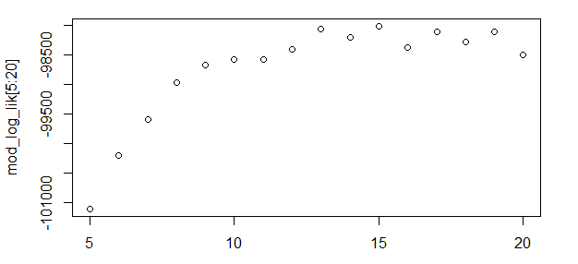
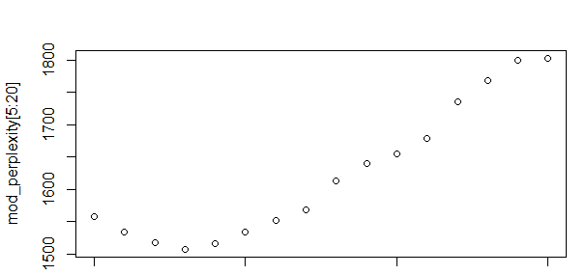
Key challenge
Finding the appropriate K
K value – how many topics
Well if I knew that I wouldn’t be doing this!
Try for a good estimate
Use perplexity or log-likelihood
Measures of topic coherence
Looking for sudden jumps
Low perplexity is related to better generalization
Log likelihood tends to be more useful, but recent studies suggest human interpretation may be best

Slide 10
OTHER COMPLEXITIES
hyperparameters
Alpha represents document-topic density - with a higher alpha, documents are made up of more topics, and with lower alpha, documents contain fewer topics.
Beta represents topic-word density - with a high beta, topics are made up of most of the words in the corpus, and with a low beta they consist of few words.
Suggest default ~ 1./#of topics

